Slide 1
Unit 3
Chapter 6
Lesson 1
Day 2
Pages 154-159

Slide 2
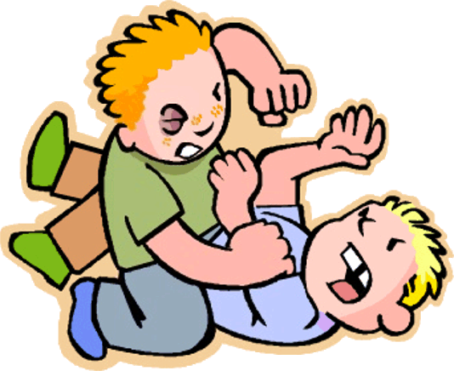
Please Do Now!
Have you ever had a disagreement that ended in a fight? Explain in three lines what happened.
Share with a partner.

Slide 3
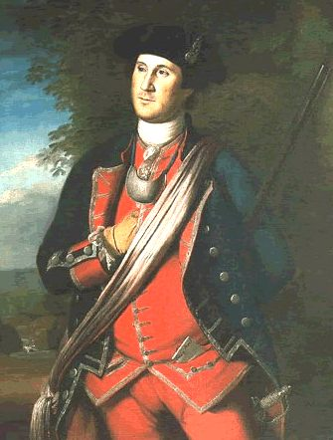
Dinwiddie sent a young man from the British army named George Washington to Fort Le Boeuf to tell them to leave. The French refused.

Slide 4
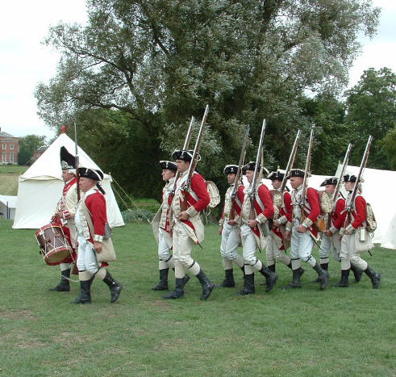
Several months later, Washington was sent back to the area with soldiers to protect British colonists in the area from the French.

Slide 5


Slide 6
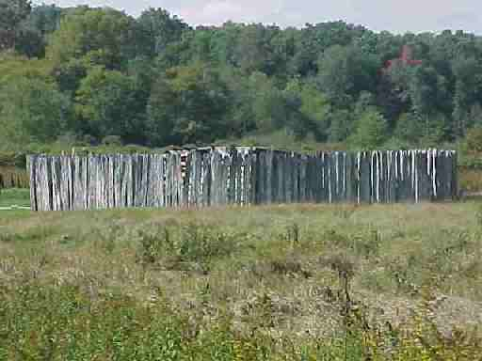
Worried about being attacked by a larger French force from Fort Duquesne, Washington built Fort Necessity for protection.

Slide 7
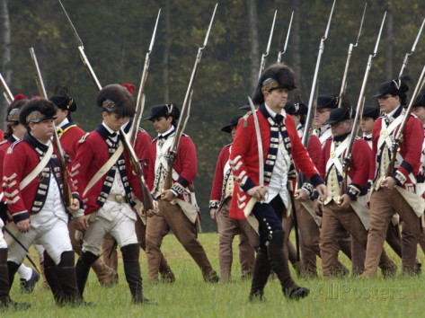
On July 3, 1754, the French did attack, laid siege to the fort, and forced Washington to surrender.

Slide 8
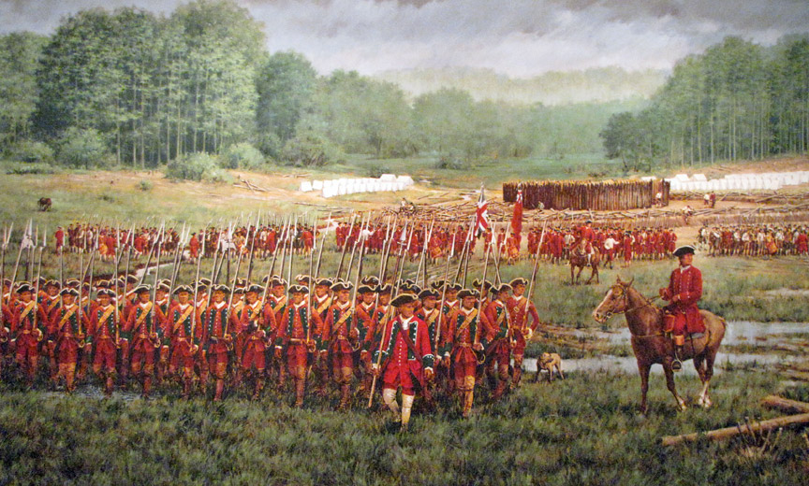
Washington and his troops returned to Virginia. Many say this was the beginning of the French and Indian War.

Slide 9
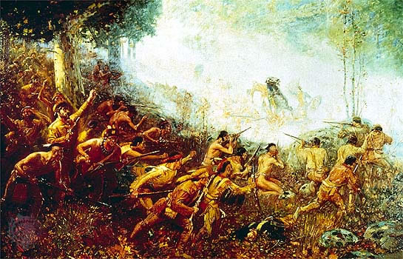
The French, along with their Native American allies, fought the British for control of the North American continent for nine years.

Slide 10
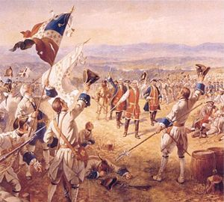
The British lost many early battles in the war to the French.

Slide 11
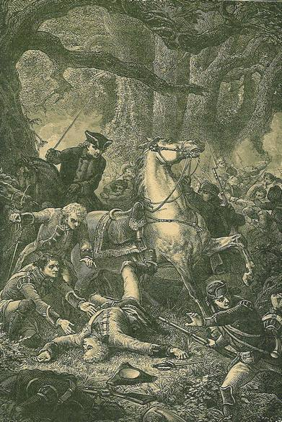
One of those losses was on July 9, 1755, when General Edward Braddock lost the Battle of the Monongahela. Braddock was killed in the fight.

Slide 12
“Quote” and Comment
Write three lines explaining what you think about the story about George Washington during the Battle of the Monongahela.
Share with your partner.

Slide 13
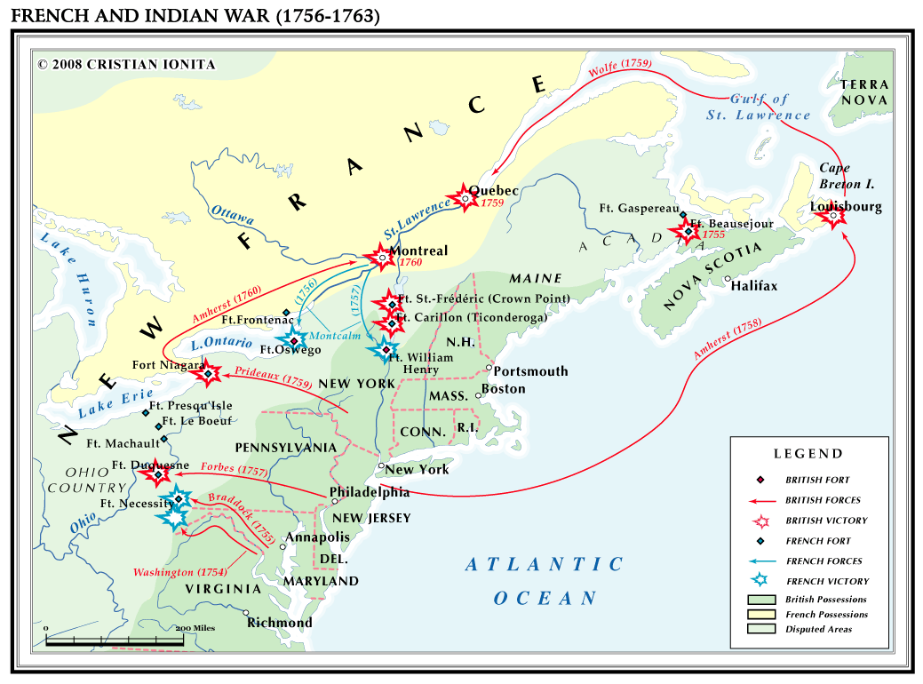
As the war continued, things started going better for the British, and they began to win more battles.

Slide 14
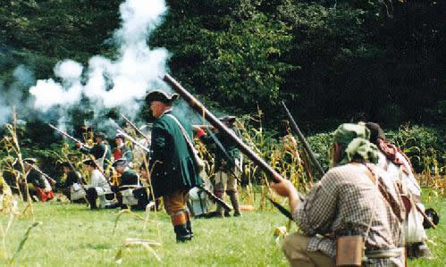
One victory for the British was in 1756 when Pennsylvanian John Armstrong led an attack on the Native American village of Kittanning, capturing it.

Slide 15
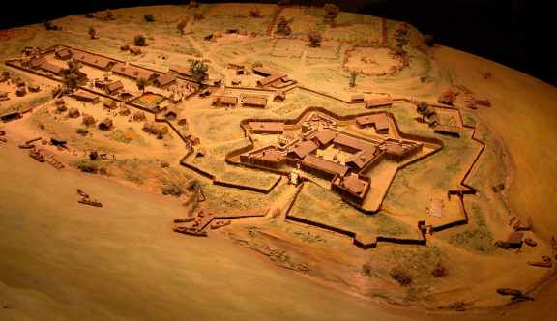
Fort Duquesne finally fell into British hands in September of 1758. The French burned it down so the British couldn’t use it.

Slide 16
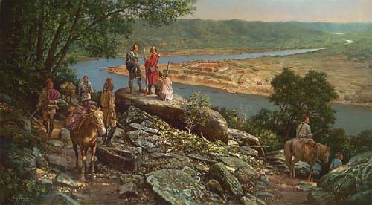
The British built Fort Pitt in place of Fort Duquesne.

Slide 17
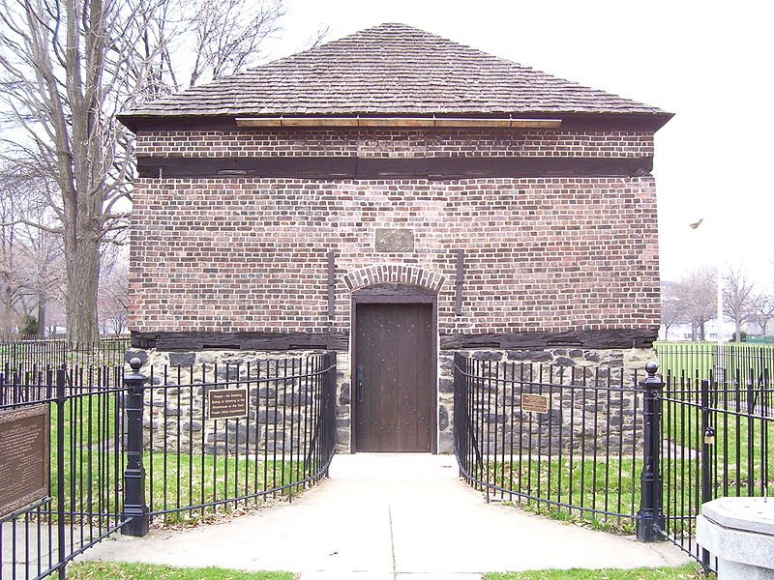
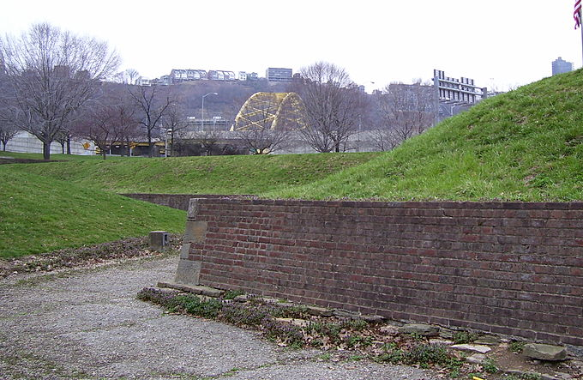
Remains of Fort Pitt today.

Slide 18
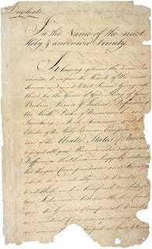
The British finally won the war, and in 1763 the British and French signed the Treaty of Paris.

Slide 19
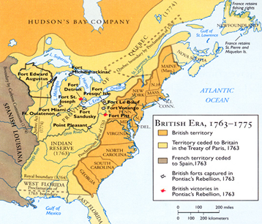
This officially ended the war and gave England control of North America from the Atlantic Ocean to the Mississippi River.

Slide 20
Exit Question
List one effect of the French and Indian War.

